Slide 1
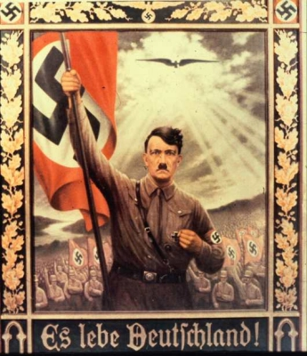
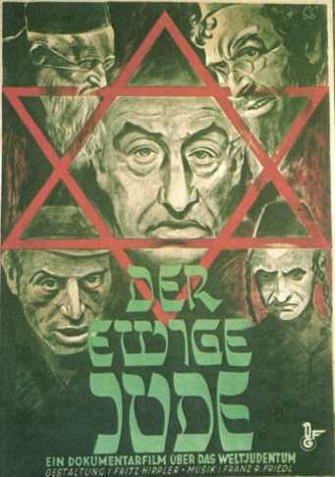

Slide 2
Propaganda: Aims of Lesson
To understand…..
The meaning of propaganda and censorship.
The methods of propaganda the Nazis used.
The effectiveness of Nazi propaganda and censorship in controlling the population.

Slide 3
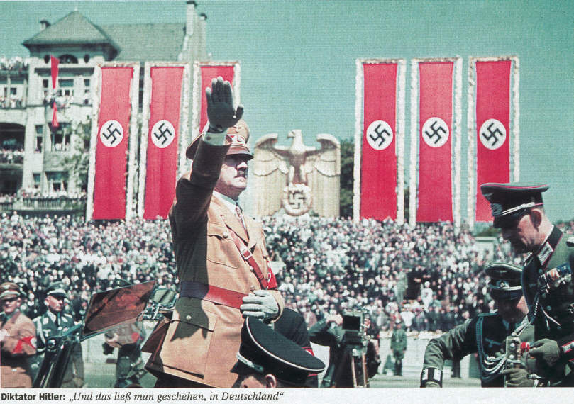
Nazi Propaganda & Censorship

Slide 4
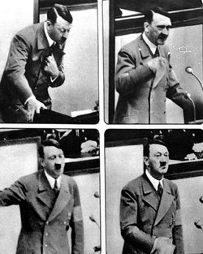
Propaganda
Propaganda is the use of the Media to promote one point of view.
Propaganda is brainwashing the public, convincing them of an ideological viewpoint.

Slide 5
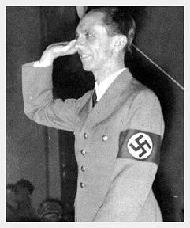
Goebbels
Minister of Public Enlightenment
Responsible for running the Nazi Propaganda machine
Tasked with ensuring views of Nazi party were persuasive.

Slide 6
Propaganda
Activity
In pairs discuss ways in which a government could attempt to brainwash the population. Make a brief note of your ideas.

Slide 7
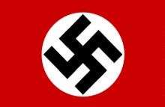
Nazi Propaganda: Methods
Posters
Radio
Film
Newspapers

Slide 8
Nazi Propaganda
The Nazis recognised the value of the media.
Nazis used aggressive advertising to promote nazi ideology
Goebbels was in charge of enlightening the German public.

Slide 9
Nazi Propaganda focussed on:
Anti-Semitism (anti-Jew)
Militarism (uniforms; army)
Nationalism (pride in Germany)
Supremacy of the Aryan race
Cult of the Fuhrer (Hitler focal point of nation; god-like figure)
Traditional German ‘Volks’ culture

Slide 10
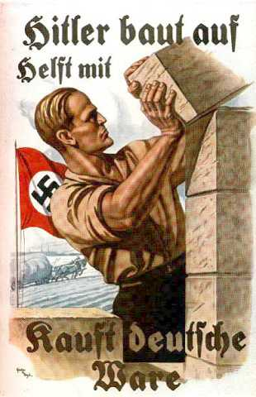
Posters
Posters - cheap & easy to distribute
Placed in prominent positions
Constant reminder of Nazi ideology

Slide 11
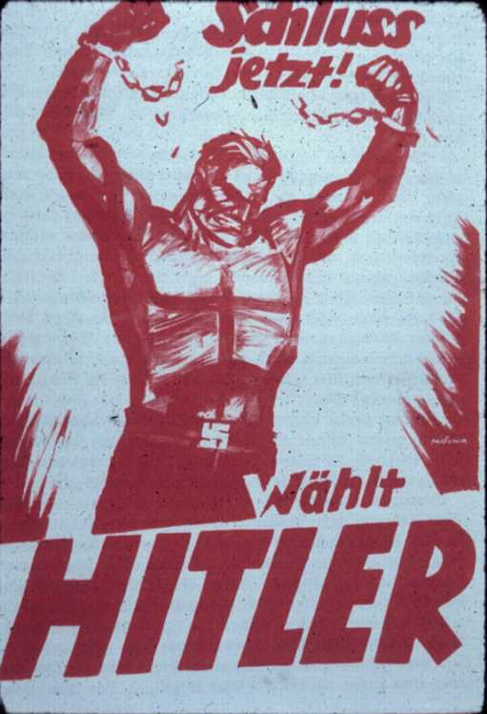
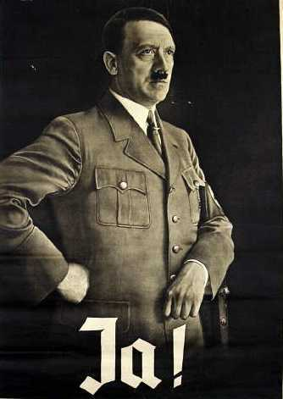
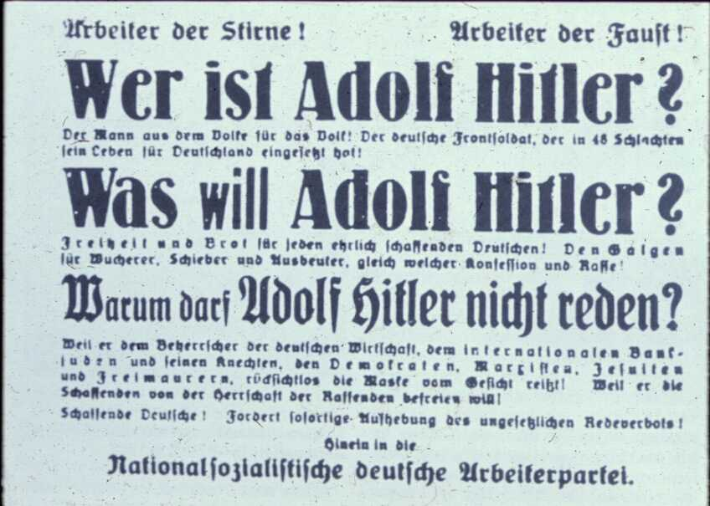
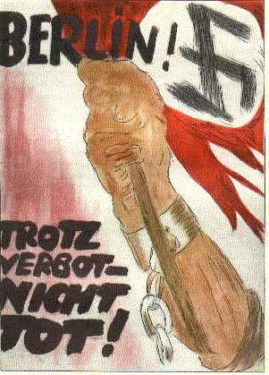
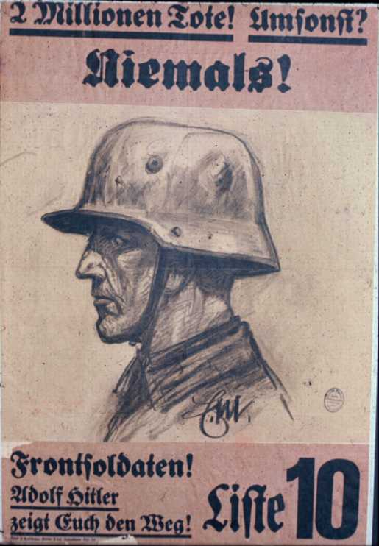
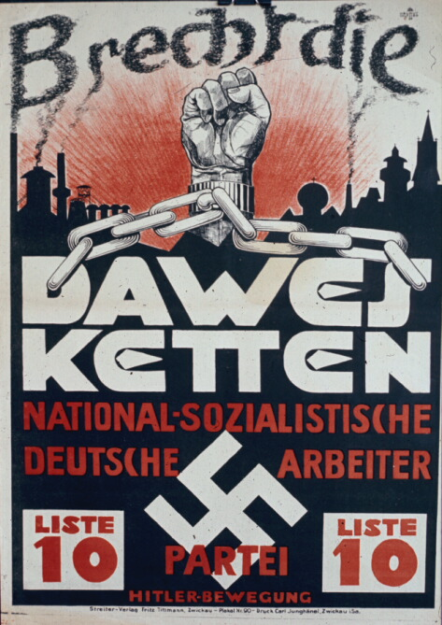
Examples of Nazi Posters

Slide 12
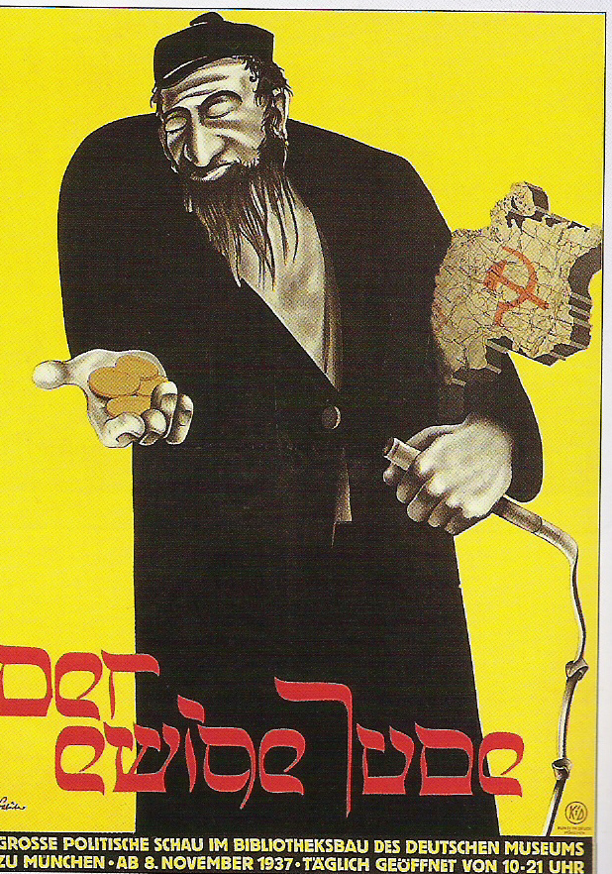

Slide 13
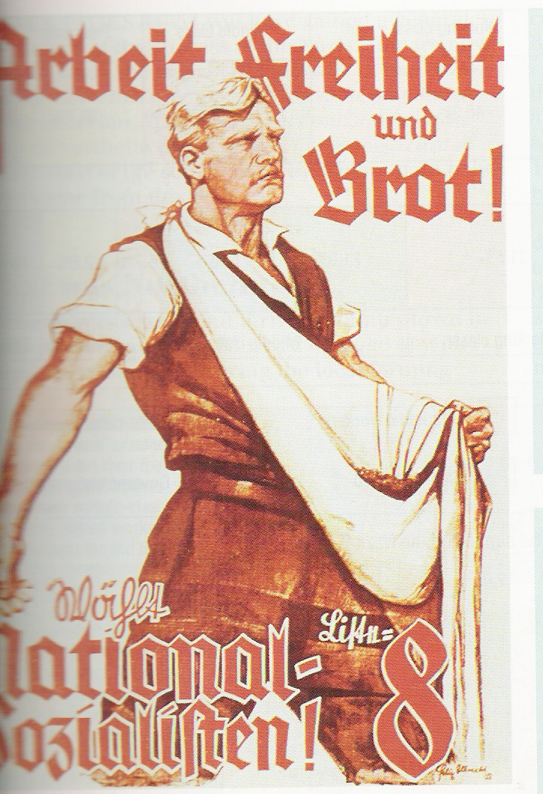
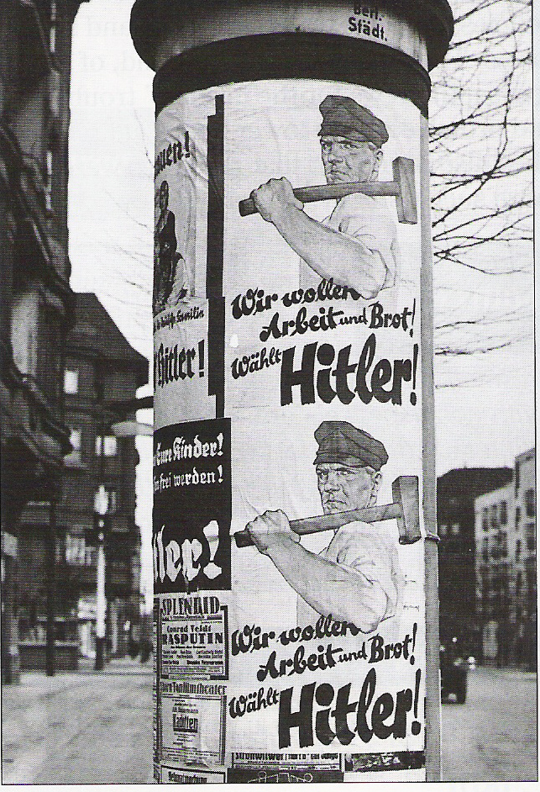

Slide 14
Radio
1) The Peoples Receiver – limited range in order to only hear Nazi broadcasts (could not pick up foreign broadcasts)
-All news broadcasts came through the Nazi Office of Propaganda
-Between 1932-9 the number of families with radios rose from 25% to 70%
-Goebbels described radio as “the spiritual weapon of the totalitarian state”
2) Hitler’s Speeches
-Hitler is considered to have been one of the greatest public speakers of all time

Slide 15
Film
Film was used to show Hitler in a positive light as often as possible
Film going quadrupled between 1933 and 1942
Over 1000 films produced during the Third Reich
Nazis often used newsreels shown before the start of feature films
The Nazi’s commissioned several films, each carefully portraying a certain image – try to think what this may have been…

Slide 16
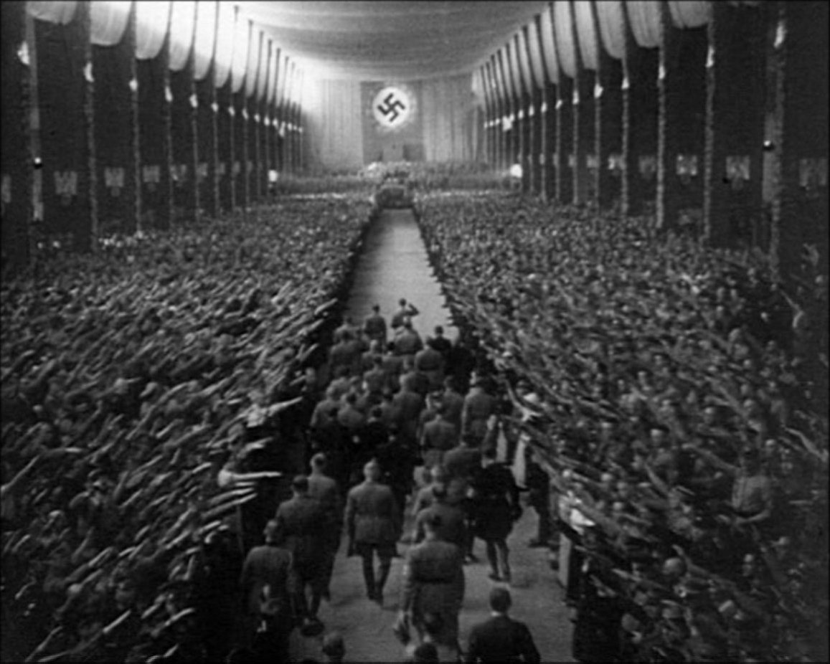
1934 –Triumph of the Will –film that chronicles Nazi rally

Slide 17
Newspapers
Censoring newspapers ensures that only the news you want people to read is available to the public
October 1933 new law made editors responsible for infringements of government directives
Clause 14 obliged editors to exclude anything ‘calculated to weaken the strength of the Reich’
Treason to spread false news or rumours
Many publications banned.
…………..1933 there were 4,700 daily newspapers, 3% controlled by NSDP (Nazi party)
…………..1944 there were only 997 daily newspapers, 82% of which were controlled by NSDP.

Slide 18
Control of the newspapers
Eventually, directly or indirectly, the Press was controlled by Eher Verlag (Nazi publishing house)
RMVP (Ministry for Enlightenment and Propaganda) told editors where to place articles
Nazi Press Agency supplied estimated 50% of content
From 1933 all editors and journalists had to be accredited by Goebbels

Slide 19
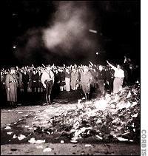
Censorship-Books
In 1933 there were book burnings at the universities of Berlin and Nuremberg
10 May 1933 central square in Berlin the largest book burning event took place
Raids on public and private libraries
Goebbels wanted to eradicate ‘overstated Jewish intellectualism’
Books burned which were Jewish, socialist or pacifist by nature

Slide 20
Censorship
Censorship prevents people from hearing anyone else’s ideas
Do you think censorship exists in today’s world?
In 2002, China banned the search engine Google.
Can you think why?

Slide 21
Censorship
Goebbels aimed to ensure nobody could read/see anything that was hostile/damaging to Nazi party
He worked with SS & Gestapo to achieve this aim
What part did the Gestapo/SS have to play in censorship?

Slide 22
How did Hitler keep control of Germany?
The Terror State
Propaganda
Secret police called the Gestapo would spy on and arrest enemies of the state.
Mass Rallies, Posters and Propaganda films.
Keeping Control of Germany
The Nazis controlled and censored the radio & newspapers.
SS were responsible for running the concentration camps.
School children were indoctrinated with Nazi ideas at school.
Everyone was scared of being arrested by the Gestapo and being put in a concentration camp.
Popularity
Ripping up the Treaty of Versailles.
Hitler Youth & the Young Maidens.
Creating Jobs

Slide 23
Task:
Answer the following questions in full sentences
Radio; receiver; Hitler’s speeches
What is propaganda?
What is censorship?
Nazi propaganda and censorship
3) Construct a mind map showing the different elements of Nazi propaganda and censorship.
4) What effect did Nazi propaganda have on the German population?
5)What was Nazi propaganda designed to make Germans think about the Nazis and about German Jews?

